Slide 1
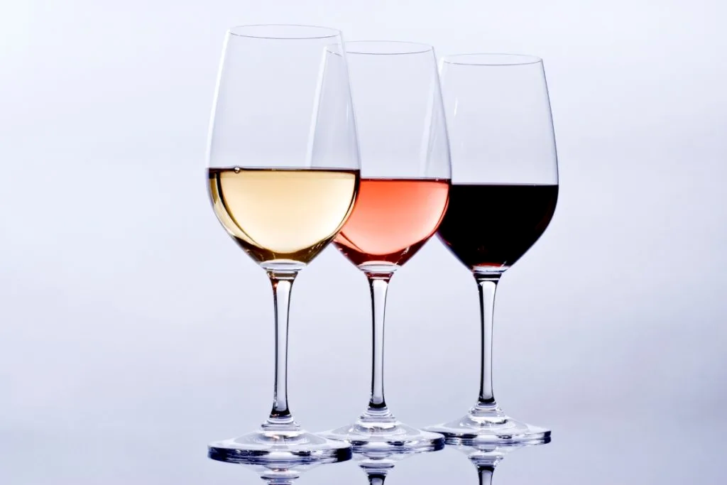
Modeling Wine Quality Using Physiochemical Properties
A Data Mining
Analysis By Clement Chen

Slide 2

The Problem:
Wine quality is difficult to quantify
Human tasting is currently the main way of distinguishing wine quality
Inconsistent and prone to bias
Is it possible to accurately model
wine quality based on physiochemical
properties of the wine?

Slide 3

Business Case I: Small Family-Owned Winery
• A small business like this receives most of their revenue from individuals willing to pay top dollar for high quality wines.
• In order to retain their clientele, this business must make certain that the wines they sell are always of top quality. One bad wine could mean losing years of future profits.
• A business like this would be interested in a model that has high precision, that is to ensure that of all the wines labeled high quality, an overwhelming majority are truly high quality thus minimizing the chance that a loyal customer would receive a low-quality wine.

Slide 4
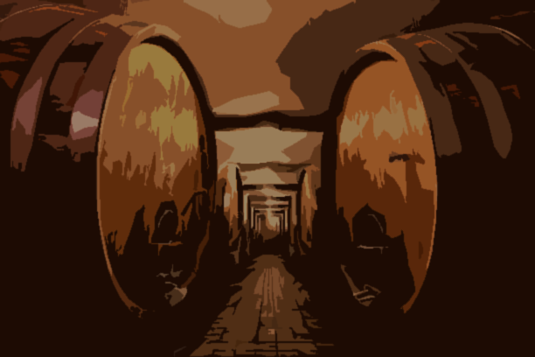
Business Case II: Large Winery
• A large winery would supply wines in boxes of 6 to retailers such as Costco or Walmart. As such, they are okay if not all the wines in the boxes are of the highest quality. From internal focus group tests, they have found out that consumers buying wine in bulk are okay with some of the wines being of lower quality because of the already cheap prices.
• In order to not waste lower quality wines, they purposely package some lower quality wines with higher quality wines instead of getting rid of all low-quality inventory.
• A business like this would be okay with a model that has lower precision, that is to ensure that of all the wines labeled high quality, a moderate fraction are truly high quality allowing less production loss due to rejected products.

Slide 5
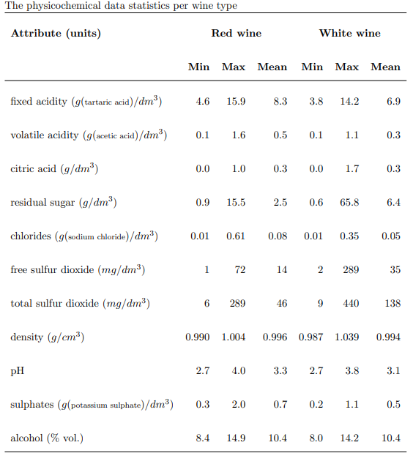
Data Information
• Source University of Minho, Viticulture Commission of the Vinho Verde region (CVRVV)
•Each row contains a wine sample
• Contains two data sets
• Red wine 1599 samples
• White wine 4898 samples
• 11 feature columns 1 class label column
• Class labels are a quality rating from 0-10 based off the median value of at least 3 wine experts
• CSV format

Slide 6
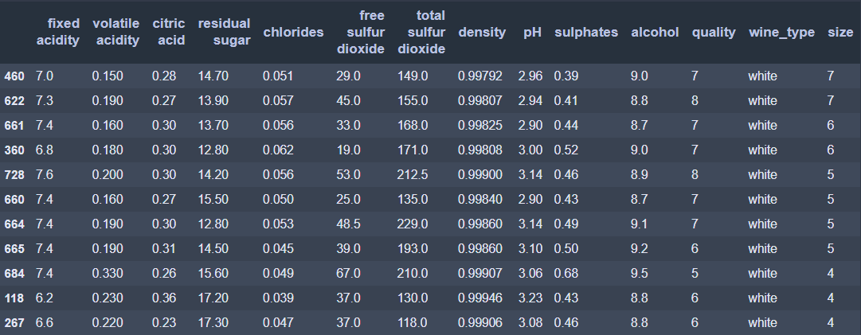
Data Wrangling
Data were very clean
Many duplicate rows
Based on the unlikely chance that feature values were coincidentally the same values, and metadata stating wine quality is the median value of at least 3 wine experts, we can conclude that these are true duplicates
Table of some of the duplicate values removed.
The ‘size’ column represents the number of the duplicate rows found.

Slide 7
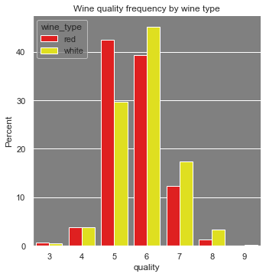
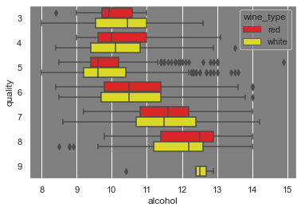
EDA
• White wines tend to have higher quality then red wines
• Most wines are in the 5-6 quality range
• Alcohol volume seems to be an important factor in determining wine quality for both red and white wines
• Higher alcohol content can be the result of • Higher sugar content from the grapes
• More sugar being turned into alcohol
• Length of fermentation

Slide 8
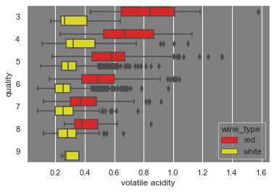
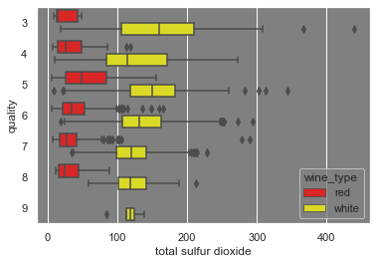
• Volatile acidity (acetic acid) is a significant indicator of quality in red wines
• Acetic acid content is the result of naturally occurring bacteria processing alcohol and oxygen into acetic acid
• Less total sulfur dioxide is an indicator for higher quality in white wines
• Sulfurs are added into wines for stability and to protect against oxidation but in this case, a tradeoff was made.

Slide 9
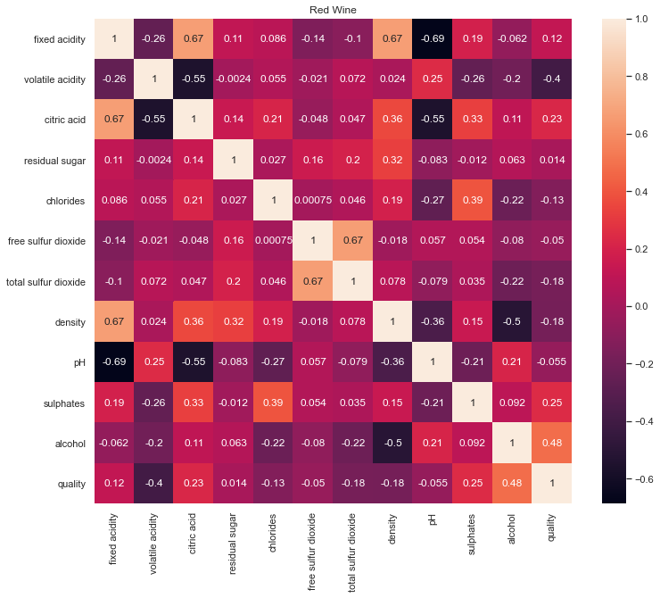
Red Wine Correlated Features
Feature 1 | Feature 2 | Correlation
Fixed Acidity | pH | -0.69
Fixed Acidity | Density | 0.67
Fixed Acidity | Citric Acid | 0.67
Total Sulfur Dioxide | Free Sulfur Dioxide | 0.67

Slide 10
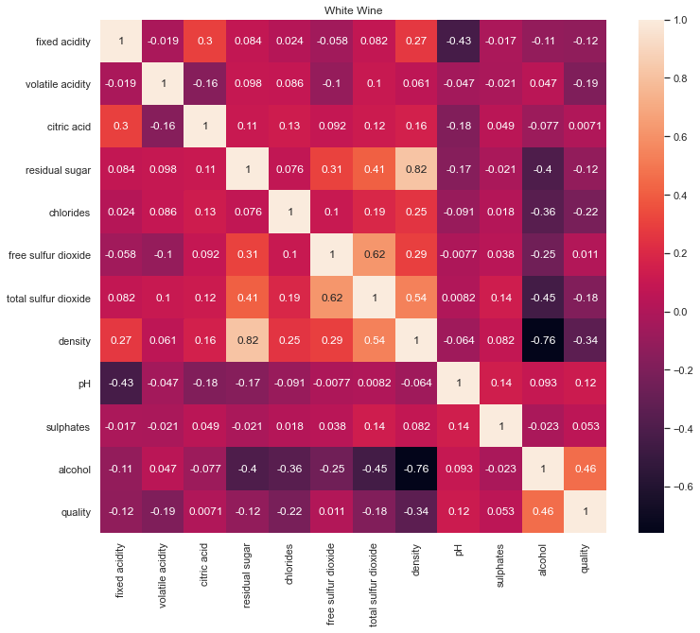
White Wine Correlated Features
Feature 1 | Feature 2 | Correlation
Residual Sugars | Density | 0.82
Density | Total Sulfur Dioxide | 0.67
Alcohol | Density | -0.76
Total Sulfur Dioxide | Free Sulfur Dioxide | 0.62

Slide 11
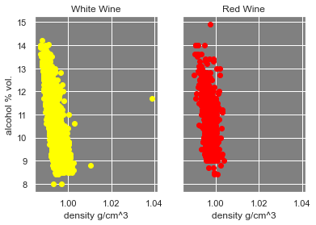
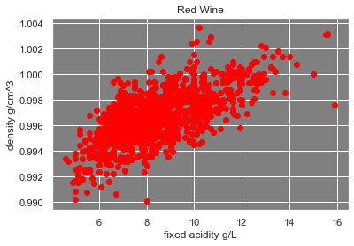
Some features appear to be highly correlated to each other. Depending on the machine learning algorithm used, multicollinearity could be an issue.

Slide 12
Preprocessing
Data Preprocessing:
1. Train-test split of ratio 80-20
2. Training data was fitted with RobustScaler
3. Test data was scaled with the fitted RobustScaler to prevent data leakage 4. Data was binned into low (0-6) and high (7-10) quality to create a binary classification task
Data
Transform
low (0-6)
20
RobustScaler
80
Bins
Fit + transform
High (7-10)

Slide 13
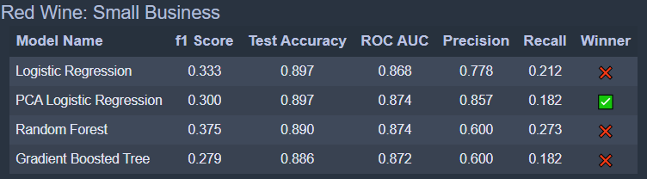
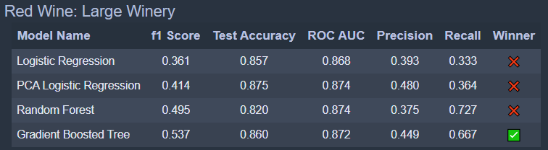
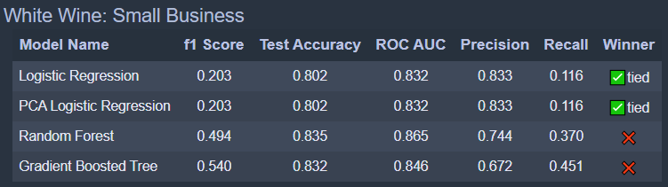
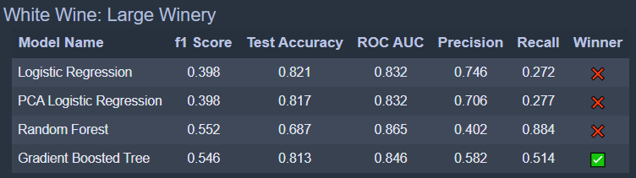
Modeling Results
Classification Algorithms Used
Logistic Regression
Logistic Regression with PCA
Random Forest
Gradient Boosted Trees
Hyperparameter Tuning
5-fold CV with GridSearchCV and RandomizedSeachCV
Scoring
ROC_AUC was used for scoring models

Slide 14
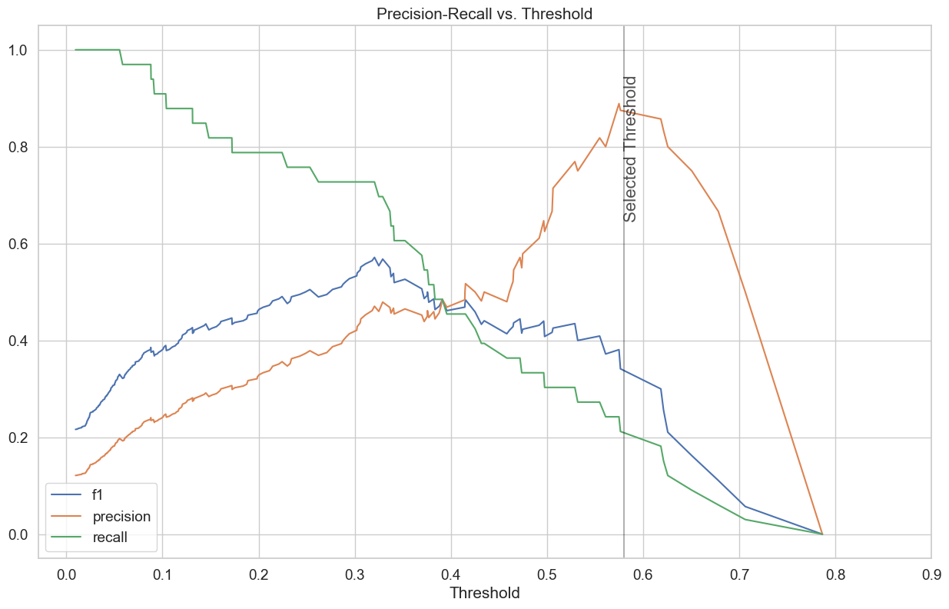
Threshold chart on red wine test data from winning PCA Model for small family-owned business

Slide 15
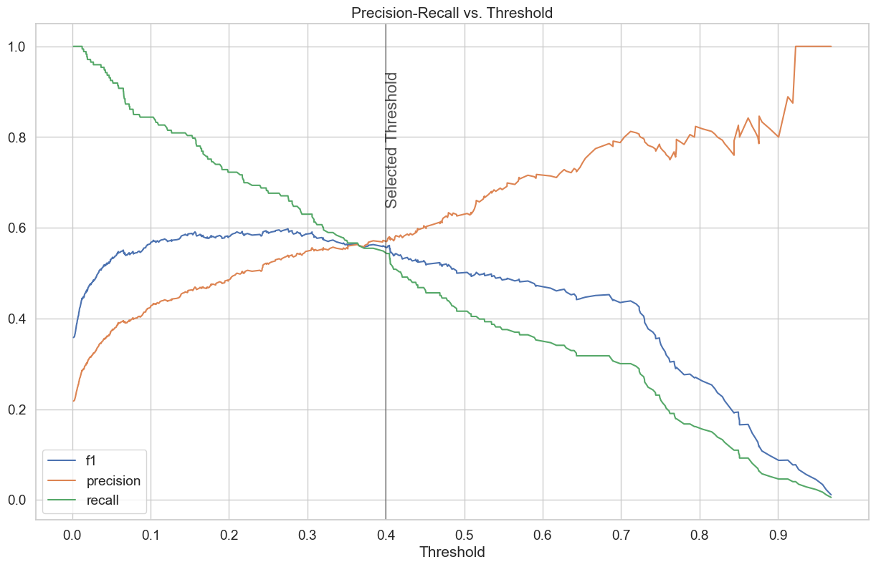
Threshold chart on white wine test data from winning GBT Model for large winery

Slide 16
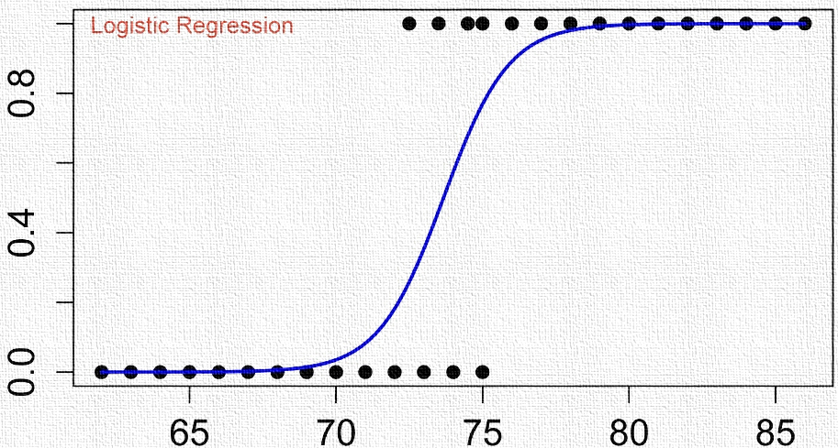

Conclusion
The dataset is made of many duplicates which have been classified as true duplicates and removed prior to modeling.
The red wines tend to have lower quality than the white wines.
Logistic Regression-based Models won for the small business thresholding while Gradient Boosted Tree Models won with large wineries.
The results of this analysis would be useful for owners of small family-owned wine shops looking to retain loyal high paying customers or R&D departments at large wineries looking to maximize sales by reducing product recall.

Slide 17
Ideas for Future Research
Apply New Machine Learning Algorithms
More Robust Labeling of Sensory Data
• Neural Nets
• Support Vector Machines
Wine quality pulled from the median of more than 3 tasters, possibly from different regions or from markets with different palettes
Acquired More Features
• Wine Color
• Wine Price
• Wine Name
• Carbonic Acid Levels (carbonation)
• Cask or Bottle Fermented
Focus on Improving Red Wines
White wine had proportionally 30% more high quality wines than the red wine data. Efforts could be directed to improving red wine performance.
Adjust Optimization Metric
Target regression on wine price instead of classification of wine quality

Slide 18

Cheers!

